Slide 1
Enhancing SPS Chapter Engagement Through Data Automation and Analysis.
Presented by Collins Munene Kariuki.
Supervised by Dr. Alejandro de la Puente,
with help from Rianna Ehrenreich.
Role: Society of Physics Students (SPS) Program Engagement Summer Intern.
Where: American Institute of Physics (AIP).

Slide 2



What Is the Grand Scheme of Things?
Support & Enrichment
Monitoring Chapter Involvement
Purpose of Chapter Reports
SPS is dedicated to supporting every undergrad student interested in Physics.
SPS offers enriching opportunities at local, regional, national, & international levels.
Assists departments in helping their students succeed.
SPS monitors the involvement of its chapters to enhance engagement.
Develops strategies to activate dormant or inactive chapters.
Requests chapter reports to assess the health of its chapters across different zones.
Gather contact information from active chapters.
Understand chapter and society activities at the grassroots level.
Collect information for inclusion in SPS publications.

Slide 3
What Is the Grand Scheme of Things?
SPS aims to build a thriving community of physics students by providing robust support & fostering engagement. Through meticulous monitoring & comprehensive chapter reports, SPS ensures that it can effectively support active chapters and strategically reintegrate inactive ones. The goal is to create an environment where students are not only academically successful but also professionally prepared and personally enriched, contributing positively to the scientific community.

Slide 4


What Was I Tasked With?
Primary objectives
Responsibilities of SPS staff
Review and Processing:
Review & process over 200 chapter reports from SPS chapters.
Ensure accurate and up-to-date records in zone-specific databases.
Organize the collection of chapter reports.
Manage the data collected from reports and analyze the data to update the YM database.
Create chapter activity reports to share with the council.
Automation Implementation:
Develop an automated system for updating activity reports using a technique of my choice, significantly streamlining the process for chapter activity reports.
Timing: I joined during the chapter activity reports period where the main task was to create the chapter activity reports.

Slide 5
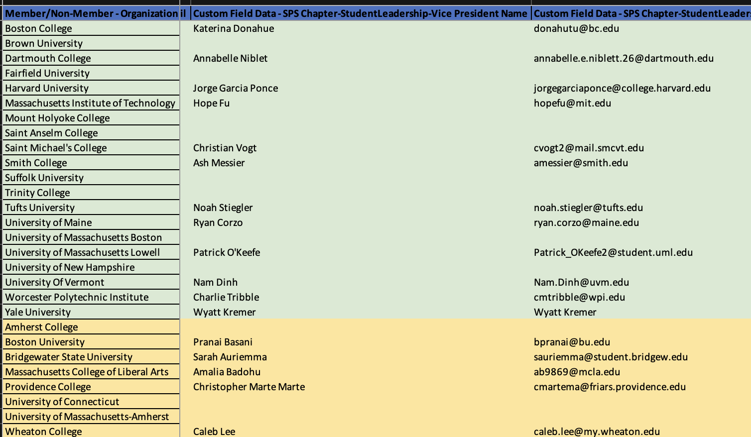
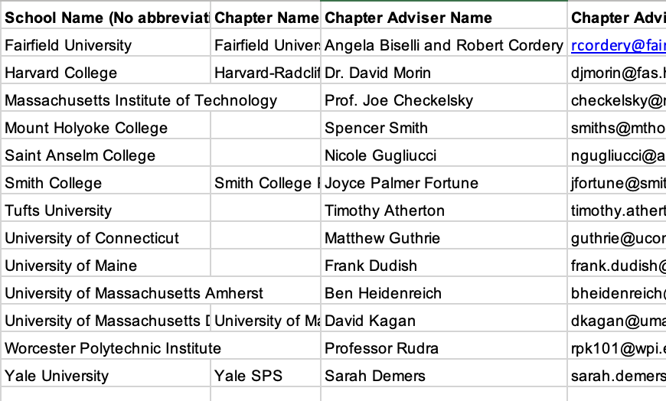
What Is the Current State of Affairs?
[2] Locate the corresponding school or chapter name in the ”destination file” (the previous year’s activity report).
[1] Locate a specific school row in the “source file”* (the zone-by-zone chapter report submissions).
[3] Repeat.
*The source file for different fields/columns may vary. For example, to obtain a particular chapter’s last Sigma-Pi-Sigma induction date, you would need to access an Excel file generated from the My Honor Society (MHS) portal.
Notes:
The current process is manual, involving extensive cross-referencing across multiple Excel files and databases.

Slide 6
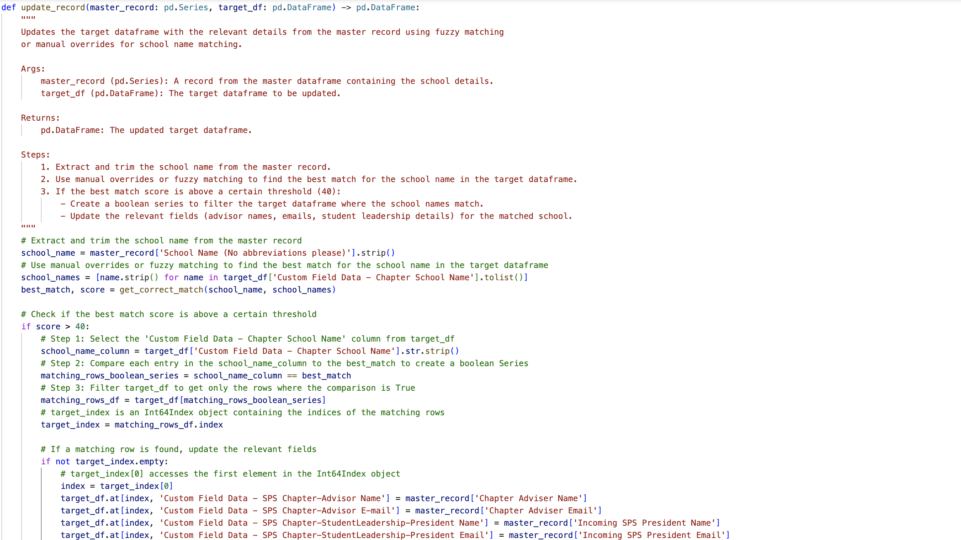
What Did I Work On?
Implemented fuzzy matching to accurately update records from multiple Excel sheets.
Fuzzy matching is a technique used in CS & data processing to identify strings that are similar but not the same. This method is particularly useful in scenarios where data may contain errors, variations, or inconsistencies, such as typos, misspellings, or different formatting.
Notes:
Manual Updates: Emphasize that over 200 schools are updated manually, which is extremely time-consuming.
___________________________________________________________________________________________
Key Concepts of Fuzzy Matching.
Similarity Scoring: Fuzzy matching algorithms assign a similarity score to pairs of strings, indicating how closely they match. Scores typically range from 0 (completely different) to 100 (identical). A higher score indicates a closer match.
Algorithms Used: Several algorithms can be used for fuzzy matching, including:
• Levenshtein Distance: Measures the number of single-character edits (insertions, deletions, substitutions) needed to change one string into another.
3. Applications:
• Data Cleaning: Identifying & correcting inconsistencies in datasets.
• Spell Checking: Suggesting corrections for misspelled words.
_______________________________________________________________________________________________
Data Loading and Preparation:
Loaded master data from ‘24 Reports Zone 1.xlsx’.
Loaded target data from ‘Zone 1 Activity.xlsx’ (specifically the ‘Activity Report’ sheet).
Loaded induction dates from ‘MHS Chapters.xlsx’.
Stripped any leading or trailing spaces in column names of the target and induction dataframes.
______________________________________________________________________________________
Used a `manual_overrides` dictionary to handle specific cases where fuzzy matching might fail. The Harvard-Marlboro problem.
______________________________________________________________________________________
Updating Records:
Implemented the update_record function (in addition to the other corresponding chapter report and induction date functions) to update chapter advisor information in the target dataframe based on the master dataframe.
Fields updated include:
______________________________________________________________________________________
Efficiency: Improved data accuracy and saved significant time by automating the update process for chapter activity reports.
Incomplete Automation:
Some fields like ‘Department Chair Name’ required manual lookups or web scraping.
Due to time constraints, focused on automating easily retrievable fields first.

Slide 7
What Did I Work On?
In the context of updating records from multiple Excel sheets, fuzzy matching can be used to match institution names that might be slightly different in each sheet. For instance, “Harvard University” and “Harvard Univ.” can be recognized as the same entity, allowing for accurate updates and data integration.
Notes:
Manual Updates: Emphasize that over 200 schools are updated manually, which is extremely time-consuming.
___________________________________________________________________________________________
Key Concepts of Fuzzy Matching.
Similarity Scoring: Fuzzy matching algorithms assign a similarity score to pairs of strings, indicating how closely they match. Scores typically range from 0 (completely different) to 100 (identical). A higher score indicates a closer match.
Algorithms Used: Several algorithms can be used for fuzzy matching, including:
• Levenshtein Distance: Measures the number of single-character edits (insertions, deletions, substitutions) needed to change one string into another.
3. Applications:
• Data Cleaning: Identifying and correcting inconsistencies in datasets.
• Spell Checking: Suggesting corrections for misspelled words.
_______________________________________________________________________________________________
Data Loading and Preparation:
Loaded master data from ‘24 Reports Zone 1.xlsx’.
Loaded target data from ‘Zone 1 Activity.xlsx’ (specifically the ‘Activity Report’ sheet).
Loaded induction dates from ‘MHS Chapters.xlsx’.
Stripped any leading or trailing spaces in column names of the target and induction dataframes.
______________________________________________________________________________________
Used a `manual_overrides` dictionary to handle specific cases where fuzzy matching might fail.
______________________________________________________________________________________
Updating Records:
Implemented the update_record function to update chapter advisor information in the target dataframe based on the master dataframe.
Fields updated include:
______________________________________________________________________________________
Efficiency: Improved data accuracy and saved significant time by automating the update process for chapter activity reports.
Incomplete Automation:
Some fields like ‘Department Chair Name’ required manual lookups or web scraping.
Due to time constraints, focused on automating easily retrievable fields first.

Slide 8
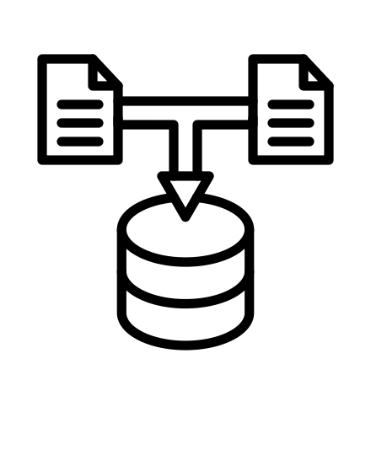


What Are the Next Steps?
Improved Data Collection
Documentation
Additional Data Collection
Future chapter report Google Forms should include hard-to-get information like the name of the department chair to consolidate all necessary data in one central location for easier retrieval.
Document the automation code, written so far, in a Jupyter Notebook with TeX notes for future interns to reference.
Add to the Standard Operating Procedure (SOP) for collecting and updating chapter reports.
Future Google Forms should explicitly ask whether the chapter has a co-advisor, as there is currently no function to update the SPS Chapter Co-Advisor column.

Slide 9
Summary of Accomplishments.
I focused on enhancing the efficiency and accuracy of SPS chapter engagement processes through data automation and analysis. I implemented an automated system utilizing fuzzy matching techniques to streamline the updating of chapter activity reports from multiple Excel sheets.
This significantly reduced the manual workload and improved data accuracy. I processed report submissions, ensuring that the records were up-to-date and accurately reflected in the zone-specific databases.
My work also involved creating chapter activity files and developing strategies for more effective data collection and future improvements, such as incorporating hard-to-get information in the chapter report Google Forms.
Through this project, I contributed to the organization’s ability to better support and engage its chapters, laying the groundwork for ongoing enhancements in their data management processes.

Slide 10
Acknowledgments
Dr. Alejandro de la Puente for making this internship work considering the many challenges we faced this summer.
Rianna Ehrenreich and Earl Blodgett for taking the time to teach me how to update activity reports.
My fellow interns for providing a friendly and welcoming environment during my time at AIP.

Slide 11
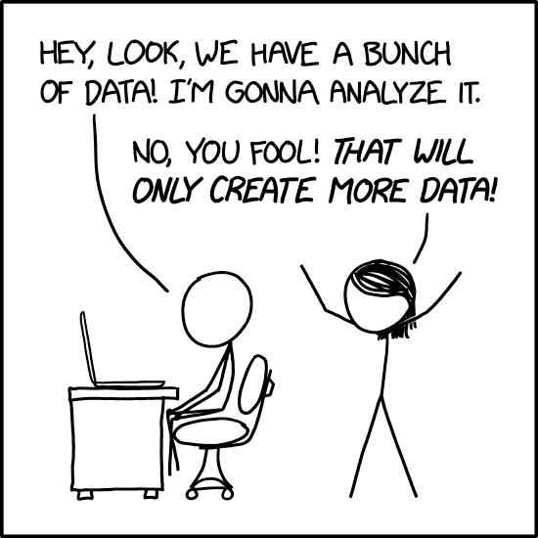
Questions?

